Slide 1
Elaboration likelihood model
By Richard E.Petty & John T.Cacioppo
（1986）
Sam Yang (13012347)
Rowan Yang (13034235)
Rongjin Zhang (13030477)

Slide 2
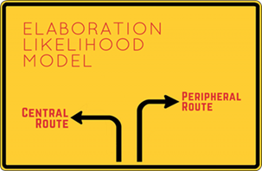
introduction
Two advertisements focused on
different ways of persuasion.
Aim of this research:
To better understand ELM using what we observed from advertisements.
To increase advertisement literacy

Slide 3
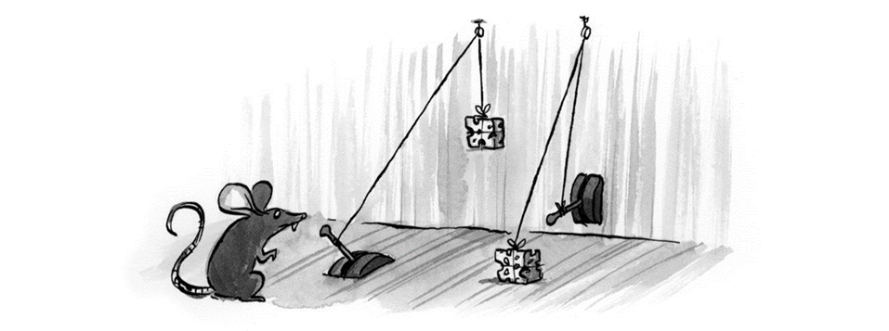
theory

Slide 4

Two routes
Central
Peripheral
Message elaboration*
Cognitive process
Scrutiny of message content
Mental shortcut process
Irrelevant cues*
Opposed to active thinking

Slide 5
Which route?
Motivation for elaboration: Do you want to think?
Personal relevance
Need for cognition
Ability for elaboration: Can you do it?
Sufficient knowledge
Requires concentration

Slide 6
What determine persuasion?
Initial Attitude
Objective elaboration
Biased elaboration
Argument Quality
Strong -positive
Weak-negative
neutral-unchanged
Peripheral Cues
Either positive or negative
Temporary, vulnerable, does not predict behavior

Slide 7
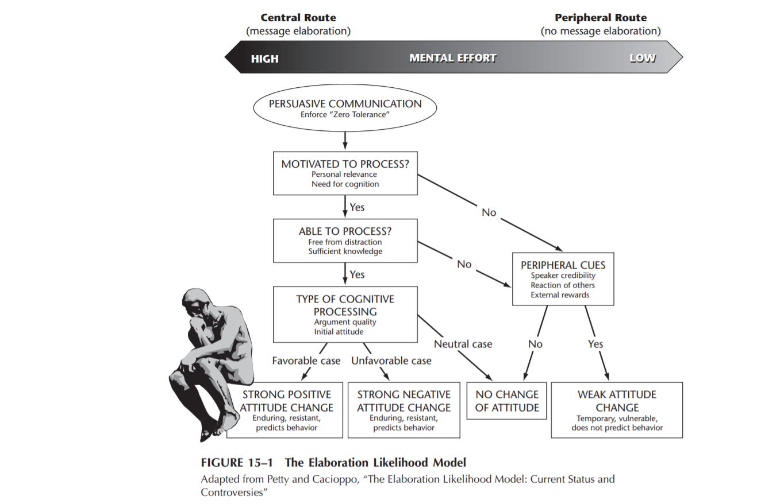

Slide 8

Method & results

Slide 9

LISTERINE®
Characteristics & Route info processing
Convincing
Personally relevant
Visualized
Concise
Both central & peripheral route

Slide 10
Potential Influence
Positive attitude
Strong
Stable
Nice & clean scenes as cues
Raises awareness of oral hygiene so that people notice LISTERINE more!

Slide 11

Jake from State Farm
Characteristics & Route info processing
Humours
Relatable
Brainwashing
Mostly peripheral

Slide 12
Potential Influence
Positive attitude towards State Farm
Creates a friendly image of State Farm agents
Unstable
Parasocial relationship with Jake

Slide 13
Conclusion
A combined form of advertisement
Argument is more persuasive
Too many arguments create information overload
We also need ads that are easy to understand (peripheral)

Slide 14

discussion
Do you think that individual differences really play an important role in how people deal with persuasive information (e.g. level of education)?
Would you say that most people nowadays process the persuasive message in a mix of the peripheral and central route?

